Slide 1
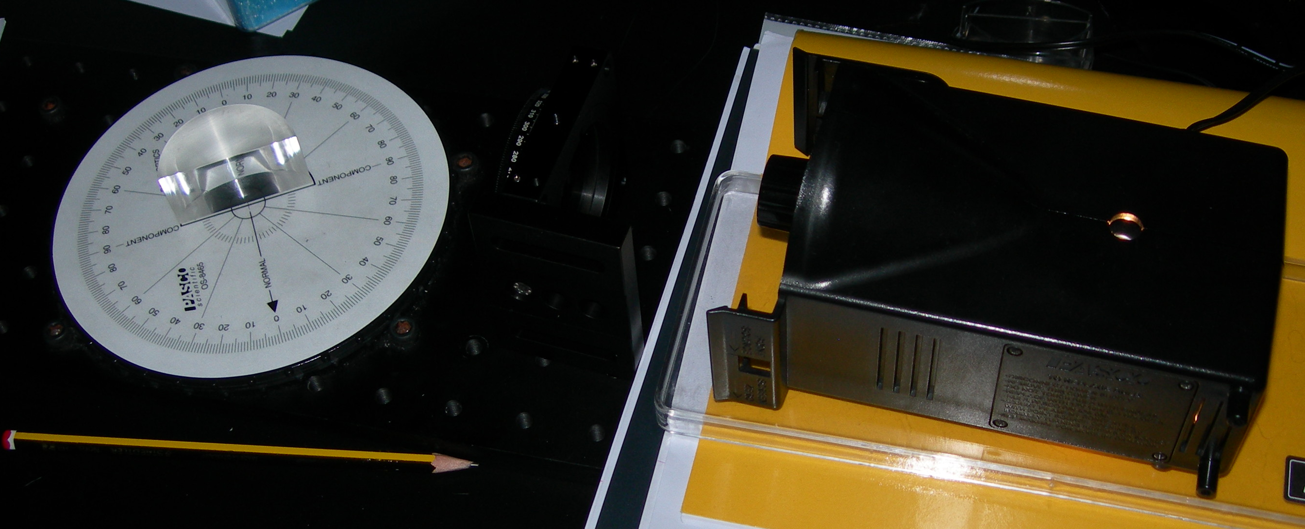
Acrylic D Shaped Lens
Filter
Ray Table Rotated Anti-Clockwise
Elevated Light Source

